Slide 1
Building Office Add-ins for Microsoft Word
Working with Text and Formatting
Notes:
Microsoft Office clients enable developers to create add-ins that extend Microsoft Word with custom functionality. Through a JavaScript API, developers can manipulate the content in a Word document from an app running in the task pane.
In this module, you'll learn how to build a Word add-in that inserts (and replaces) text ranges, paragraphs, images, HTML, tables, and content controls. You'll also learn how to format text and how to insert (and replace) content in content controls.

Slide 2

Working with Text and Formatting
Anatomy of Word Add-in
Text and Paragraphs
Styles and Formatting
Selections and Ranges
Demo
Notes:
The Word JavaScript API facilitates programmatic control over text, formatting, selections and ranges in Word documents. In this unit, you'll learn how to work with text, paragraphs, apply styles and formatting to text, and how to work with selections and ranges of text from a custom Word add-in.

Slide 3

Office 365 Platform
EXTENSIONS
Common across canvases
Action
Task pane
Dialog box
Event
DOCUMENTS
PAGES


CONVERSATIONS
CANVASES
Canvas specific
extensions
Data import
Dictionary
Connectors
Actionable emails
Navigation
Branding
Notes:
The Microsoft Office 365 platform offers a number of canvases for developers to embed customizations and Office add-ins are one of three canvases: documents, conversations and pages.
Microsoft Teams facilitates conversations between users and enables developers to extend the experience using messaging extensions, conversational bots, and other customization options.
Developers customize pages in SharePoint Server and SharePoint online using the SharePoint Framework.
Office clients, such as Word, Excel, PowerPoint, OneNote, and Outlook can also be extended to implement custom task panes, actions, and additional customizations using add-ins.

Slide 4
Anatomy of Office.js Add-in for Microsoft Word
Initialize Office when Add-in page first loads via Office.initialize
Office.initialize = function (reason) {
if (!Office.context.requirements.isSetSupported('WordApi', 1.3)) {
console.log(‘Unsupported client’);
}
else {
Word.run(function (context) {
// Do Word stuff
context.load(obj, obtions);
return context.sync()
.then(() => {
// Do more Word stuff
});
})
.catch(function (error) {
console.log("Error: " + JSON.stringify(error));
});
}
Check if client supports API version
Get context to perform operations
Load desired properties
Sync context to execute batch operations
Use promises to get results or perform additional operations
Handle errors
Notes:
We'll start by looking at an anatomy of an Office.js for Microsoft Word:
- All Office add-ins must call off the `Office.initialize()` method when a page first loads the add-in.
- If you're using a newer Office.js capability in your add-in, its important to check if the client supports those extensions and you can check that using the `requirements` object.
- For the Word JavaScript APIs, you will use the `Word.run()` method to get an instance of the current document `context`.
- Once you have a reference to the current Word document's `context`, you can load any properties on the context using the `load()` method. This method will add the request queue, allowing you to chain multiple requests together for performance reasons.
- When you're ready to retrieve the properties you queued up, or to perform any queued actions, use the`context.sync()` method to execute the batch of queued operations defined using the `load()` method.
- The `context.sync()` method returns a JavaScript promise that can be used to get results or a previous operation and/or perform new operations.
- As a best practice, you should listen for, catch, and handle any errors that might occur when working with the Word JavaScriopt APIs.

Slide 5
Text and Paragraphs
Hierarchy of a document
Office.js provides context to a Word document through Word.run and the context.document property.
The document contains a body, which contains a number of collections, including paragraphs, tables, and more.
The relationships in this hierarchy are exposed as properties in the API allowing traversal up (ex: paragraph.parentBody), down (ex: body.paragraphs), and horizontal (ex: paragraph.getNext() or paragraph.getPrevious()).
Paragraphs
Office.js allows you to insert new paragraphs and edit/delete/clear existing paragraphs and how they appear in a document.
Paragraphs are aware of their siblings using getNext and getPrevious operations as well as when inserting a paragraph relative to self (using “before” of “after” location).
document
body
paragraph
paragraph
paragraph
Notes:
Word add-in developers should understand a Word document's hierarchy and how that relates to the objects in Office.js.
Office.js provides context to a Word document through Word.run and the `context.document` property.
The document contains a body, which contains a number of collections, including paragraphs, tables, and more.
The relationships in this hierarchy are exposed as properties in the API allowing traversal up (ex: `paragraph.parentBody`), down (ex: `body.paragraphs`), and horizontal (ex: `paragraph.getNext()` or `paragraph.getPrevious()`).
Office.js allows you to insert new paragraphs and edit, delete, and clear existing paragraphs as well as how they appear in a document.
Paragraphs are aware of their siblings using `getNext` and `getPrevious` operations as well as when inserting a paragraph relative to self using `before` of `after` location.

Slide 6
Text and Paragraphs
// Get document body
const docBody = context.document.body;
// Insert paragraph into body (location options include “Start”, “End”, “Replace”)
docBody.insertParagraph('Hello World', 'Start');
// Get first paragraph
const paragraph = context.document.body.paragraphs.getFirst();
// Get second paragraph
const paragraph = context.document.body.paragraphs.getFirst().getNext();
// Get last paragraph
const paragraph = context.document.body.paragraphs.getLast();
// Insert paragraph after current (location options include “Before”, “After”)
paragraph.insertParagraph('Hello World', 'After');
Notes:
Here are some examples of working the the body and paragraphs of a document.
The first code sample simply gets the body of the document
Next we insert a new paragraph at the beginning of the body
The next few samples show how to get specific paragraphs in the body such as the first, second, and last. Notice how a paragraph is “sibling aware”
Finally, you can see how a paragraph can be inserted relative to another paragraph

Slide 7
Text and Paragraphs (cont.)
// Clear contents of paragraph
paragraph.clear();
// Deletes the first paragraph
paragraphs.items[0].delete();
// Inserts page break after paragraph
paragraph.insertBreak('page', 'After');
// Iterate paragraphs
const paragraphs = context.document.body.paragraphs;
context.load(paragraphs, 'text');
return context.sync().then(() => {
for (var i = 0; i < paragraphs.items.length; i++) {
// do something with paragraph (paragraphs.items[i])
}
}).then(context.sync);
Notes:
You can also clear and delete paragraphs
Insert breaks around paragraphs
And iterate through paragraphs

Slide 8
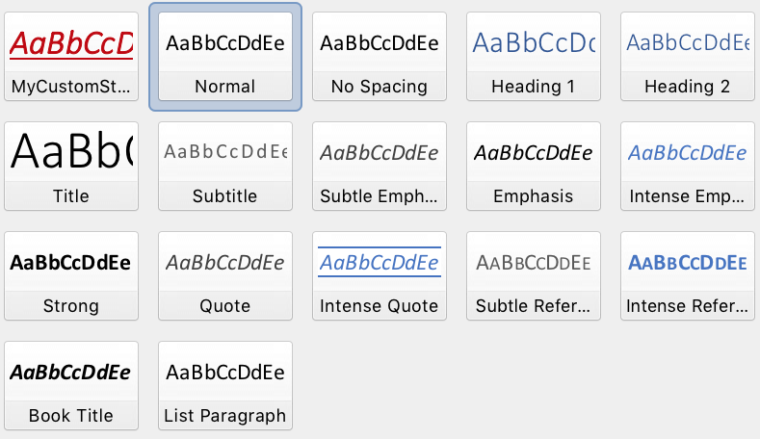

Styles and Formatting
Styles
Styles in Microsoft Word are similar to a CSS class in HTML. They provide a pre-configured and reusable set of formatting to be applied to a paragraph or range of text.
Office.js can apply both out of the box styles and custom styles to paragraphs and ranges of text.
Fonts
Modifying a font is similar to applying an inline style in HTML.
Setting a font allows you to manipulate the font family, weight, size, colors, and more.
Like styles, fonts can be applied to an entire paragraph or range of text.
Paragraph formatting
In addition to styles and fonts, paragraphs offer additional formatting through Office.js such as alignment, indention, and line spacing.
Notes:
Styles and formatting are what make an attractive document. Office.js allows you to easily work with styles and formatting from your custom Word add-in.
### Styles
Styles in Microsoft Word are similar to a CSS class in HTML. They provide a pre-configured and reusable set of formatting to be applied to a paragraph or range of text.
Office.js can apply both out of the box styles and custom styles to paragraphs and ranges of text.
### Fonts
Modifying a font is similar to applying an inline style in HTML. Setting a font allows you to manipulate the font family, weight, size, colors, and more.
Like styles, fonts can be applied to an entire paragraph or range of text.
### Paragraph formatting
In addition to styles and fonts, paragraphs offer additional formatting through Office.js such as alignment, indention, and line spacing.

Slide 9
Styles and Formatting
// Apply a known style to paragraph
paragraph.styleBuiltIn = Word.Style.intenseReference;
// Apply a custom style to paragraph
paragraph.style = 'MyCustomStyle';
// Set paragraph alignment (valid values “left”, “centered”, “right”, “justified”)
paragraph.alignment = 'centered';
// Change font of a range
range.font.set({
name: 'Courier New',
bold: true,
size: 18,
color: '#0000ff',
highlightColor: '#ffff00'
});
Notes:
The first code sample here is applying a built-in style to a paragraph
The second is applying a custom style named “MyCustomStyle” to a paragraph
Next, alignment is being applied to the paragraph…in this case making the paragraph centered
Finally, you can see a font being set for a range of text, including its font name (Courier New), bold, size, and colors

Slide 10
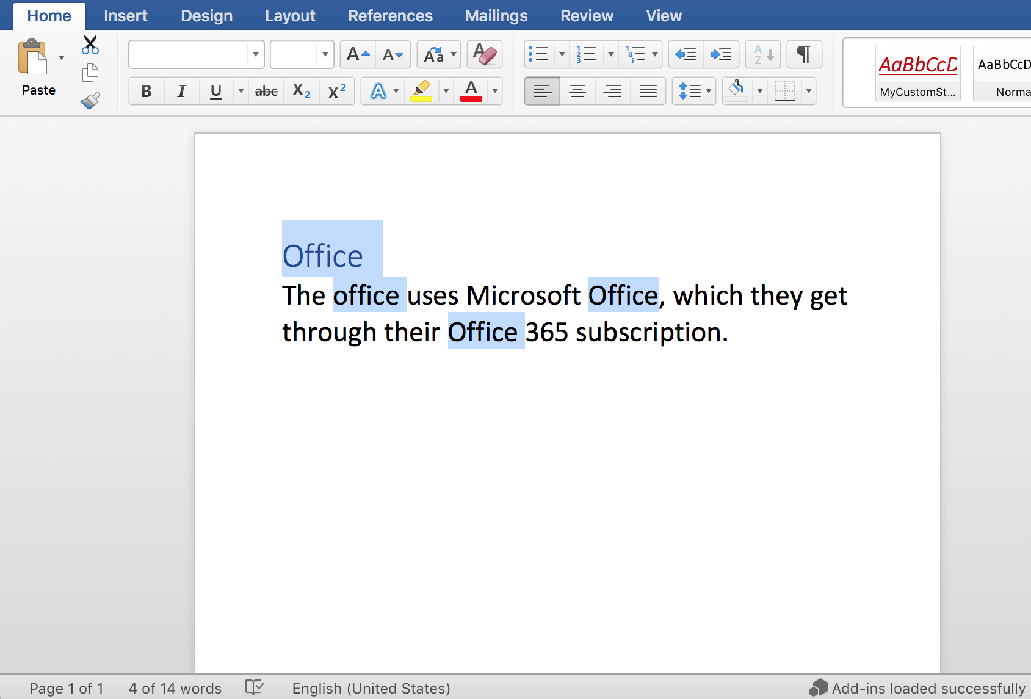
Selections and Ranges
Ranges
A range is any contiguous area of a document in Microsoft Word.
Ranges can be established through a number of ways, including search, selection, or conversion (ex: paragraph.getRange()).
Selections
Selections allow you to manipulate both the content and location of focus in the document.
You can get the selection as a range or set the selection on a range
Notes:
When working with Office add-ins, developers will often hear the term *range*. A range is any contiguous area of a document in Microsoft Word.
Ranges can be established through a number of ways, including search, selection, or through a conversion. For example, the `paragraph.getRange()` method will return the paragraph as a range.
*Selections* allow you to manipulate both the content and location of focus in a document.
You can get the selection of a range or set the selection on a range

Slide 11
Selections and Ranges
// Get selected range of text
const originalRange = document.getSelection();
// Append text to a range of text (“replace”, “start”, “end”, “before”, “after”)
originalRange.insertText(' added to the end', 'End');
// Select a range of text (selectionMode support “Select”, “Start”, “End”)
someRange.select('Select');
// Search a paragraph for a range of text and replace it
var ranges = paragraph.search('office', {matchCase: true, ignoreSpace: true});
context.load(ranges);
return context.sync().then(() => {
for (var i = 0; i < ranges.items.length; i++) {
ranges.items[i].insertText("Office", "Replace");
}
}).then(context.sync);
Notes:
The first sample here is getting the selection of the document using document.getSelection()
The next sample is inserting some text at the end of a range…insertText supports a number of location options
Next, we are selecting on a range of text…this will select that text in the document
Finally, the last sample searches a paragraph for some text and replaces each instance of that text

Slide 12
Demo
Notes:
In this demo, we will look at an add-in for Microsoft Word that manipulates text, paragraphs, and formatting of a document
Open the completed solution located in the Demos/04 All Complete folder
Run npm install
Run npm run build
Run npm start
Side-load the add-in
Launch the add-in using the Show Taskpane button in the ribbon
Click on the Insert Paragraph button to insert a paragraph
Insert two more paragraphs and make sure there are no extra new lines (ie – empty paragraph)
Create a custom style named MyCustomStyle
Click on the Apply Style button to apply a built-in style to the first paragraph
Click on the Apply Custom Style button to apply your MyCustomStyle to the last paragraph
Click on Change Font to change the font of the second paragraph
Highlight Click-to-run and click Insert Abbreviation to add the (C2R) abbreviation to the end of the range
Select Office 365 and click Add Version Info to append Office 2019 to the front of the range
Select the word several and click Change Quantity Term to replace the range several with many

Slide 13

Summary
The Word JavaScript API allows operations to be performed in batch with promises to view results and perform additional operations
The Word JavaScript API makes it easy to manipulate the text and paragraphs of a document
You can apply static formatting as well as known/custom styles to paragraphs and ranges

Slide 14
Reading further
Word Add-ins overview
https://docs.microsoft.com/en-us/office/dev/add-ins/word/word-add-ins-programming-overview
Word JavaScript API reference
https://docs.microsoft.com/en-us/office/dev/add-ins/word/
Word Add-in samples
https://github.com/OfficeDev?utf8=%E2%9C%93&q=word
Paragraph object
https://docs.microsoft.com/en-us/javascript/api/word/word.paragraph

Slide 15
Thank you

